Slide 1



TAMIL POLITICAL TEXT EMOTION RECOGNITION
HARISH .M & JYOTHSNA .V
BY GROUP 3

Slide 2
AGENDA
TABLE OF CONTENT
01
06
Introduction
Methodology
02
Problem Statement Vs Proposed Solution
07
Evaluation Metrics
03
08
Challenges Faced
Literature Review
04
09
Pre-requisites
Where we are headed
05
10
Dataset Analysis
Conclusion

Slide 3



INTRODUCTION
The realm of politics has always been a hotbed of diverse opinions and sentiments. In today's digital age, where social media platforms amplify these voices, understanding the multifaceted nature of political sentiment has become paramount.
Tamil-speaking regions, known for their dynamic political landscape, produce substantial amounts of textual data daily. Analyzing this data can reveal valuable insights into public sentiment regarding policies, leaders, and sociopolitical trends.
This emotion analysis will provide valuable insights into public opinion. By capturing the voice of the people, it can also serve as a powerful tool for predicting election outcomes.

Slide 4


PROBLEM STATEMENT
Tamil, being a low-resource language, presents unique challenges such as linguistic nuances, dialectical variations, and a scarcity of annotated data.
Existing emotion recognition models are largely trained on English and other widely spoken languages, with limited support for Tamil.
PROPOSED SOLUTION
Develop an Emotion Identification model capable of classifying emotions into one of seven distinct categories, by utilizing appropriate NLP tools to process Tamil texts, extract meaningful insights, and accurately determine sentiment.

Slide 5

LITERATURE REVIEW
1
2
A Review of Sentiment Analysis on Non-English Languages
The study highlights key challenges in sentiment analysis for non-English languages, including limited linguistic resources, datasets, and language models.
Advances in machine and deep learning, particularly multilingual embeddings and transfer learning, have significantly improved performance.
Sentiment Analysis on Arabic Facebook Comments
This research investigates sentiment classification for Arabic, addressing dialectal variations and complex morphology with deep learning techniques.
Preprocessing methods such as tokenization, stemming, and stop-word removal play a crucial role in enhancing classification accuracy.
3
4
Sentiment Analysis at Document Level for Telugu Multi-Domain Data
The study focuses on document-level sentiment classification in Telugu, demonstrating the superiority of deep learning over traditional methods.
Effective feature extraction and context-aware models are essential for improving domain adaptability in sentiment analysis.
Deep Learning-Based Analysis of Tamil Code-Mixed Text Using ULMFiT
This paper explores sentiment analysis of Tamil-English code-mixed data, leveraging pre-trained ULMFiT models for enhanced classification performance.
Spelling variations and syntactic inconsistencies in code-mixed text require specialized preprocessing techniques for accurate sentiment detection.

Slide 6
PRE-REQUISITE
UNDERSTANDING
01
10
SENTIMENT ANALYSIS
EMOTION RECOGNITION
Sentiment analysis focuses on the overall positive, negative, or neutral opinion expressed in a text chunk.
Emotion recognition aims to identify specific emotions like happiness, sadness, or anger within that text, providing a more nuanced understanding of the emotional state conveyed.

Slide 7

DATASET ANALYSIS
DATASET
OVERVIEW
The dataset consists a training set with 4,352 samples and a testing set with 544 samples, with uneven class distribution. (that may result in less accurate classification.)
CATEGORY
TYPES
🔴 Negative – Criticism or Disapproval.
✅ Positive – Approval or Agreement.
🔍 Substantiated – Well-supported claims 💬 Opinionated – Strong personal views.
😏 Sarcastic – Irony or Mockery.
⚖ Neutral – Unbiased or Factual.
❓ None of the above

Slide 8
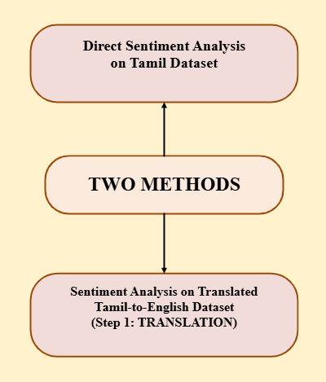
METHODOLOGY
DATA PREPROCESSING : Cleaning the text [removing special characters, stop-words, and normalizing the script]
FEATURE EXTRACTION:
Utilize Multilingual BERT embeddings to capture contextual semantics.
Leverage BERT embeddings to enhance representation.
MODEL TRAINING: Using different ML/DL models such as SVM, XGBoost, Decision trees, Random Forest classifier, ANN for classification.
COMPARISON & ANALYSIS: Evaluate the performance of all the models, comparing the metrics to decide one best model that outperforms all the others.

Slide 9

BERT- Bidirectional Encoder Representations from Transformers
BERT (Bidirectional Encoder Representations from Transformers) is a machine learning model developed by Google for natural language processing (NLP) tasks.
It uses a transformer-based architecture to understand the context of words in a sentence by analysing them bidirectionally (both left and right).
BERT is pre-trained on large text corpora and can be fine-tuned for specific tasks like sentiment analysis, question answering, and text classification. Its bidirectional nature allows it to capture more nuanced language meanings compared to traditional models.

Slide 10
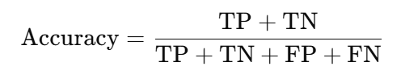


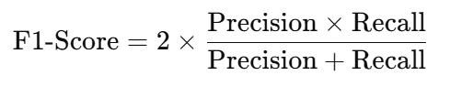
EVALUATION METRICS
1
2
ACCURACY
PRECISION
The proportion of correctly classified instances out of the total instances. It works well for balanced datasets but may be misleading for imbalanced ones.
Measures how many of the predicted positive instances are actually positive. It is crucial when false positives need to be minimized.
3
4
RECALL
F1 SCORE
Measures how many actual positive instances were correctly predicted. It is important when missing positive cases is costly.
The harmonic mean of precision and recall, balancing both metrics. It is useful for imbalanced datasets where accuracy is not reliable.

Slide 11
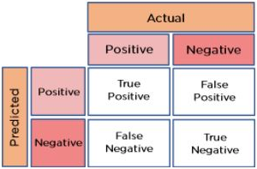

Slide 12

CHALLENGES FACED
🔹 Language Complexity – Tamil’s agglutinative nature and rich morphology make sentiment analysis challenging, requiring advanced linguistic handling. 🔹 Sarcasm & Context – Sarcasm, irony, and implicit sentiment in political discourse are difficult to detect without deep contextual understanding. 🔹 Class Imbalance – Uneven distribution of sentiment classes skews model predictions, requiring techniques like oversampling or balanced loss functions. 🔹 Translation Errors – Tamil-to-English translation may introduce semantic shifts, affecting the accuracy of sentiment classification. 🔹 Computational Cost – BERT-based models demand significant processing power, necessitating optimization strategies like quantization or distillation.

Slide 13
WHERE WE ARE HEADED
BERT for CLASSIFICATION : BERT-based sentiment classification leverages bidirectional context understanding, enabling it to capture nuanced meanings, sarcasm, and implicit sentiments for more accurate predictions.
LLMs (Large Language Models) use context-aware analysis to detect nuanced emotions, sarcasm, and implicit meanings, assign probabilistic sentiment classifications (positive, negative, neutral), and can be fine-tuned for accuracy in domain-specific applications.

Slide 14
CONCLUSION
In this study, we aim to explore Tamil Political Text Emotion Recognition using NLP techniques to classify emotions accurately.
We plan to further analyze the dataset, apply BERT/Multilingual BERT (MBERT) embeddings, and compare models like Random Forest, XGBoost, and deep learning approaches to evaluate their effectiveness.
While challenges such as language complexity, class imbalance, and sarcasm detection remain, we look forward to understanding the potential of advanced NLP models for sentiment analysis in Tamil.

Slide 15
THANK YOU
BY GROUP 3

